Slide 1

Automation Testing
By- Manas

Slide 2
VALIDATION COMMANDS IN WEBDRIVER
We are using these commands to perform validations in Webdriver.
isDisplayed ():
To verify whether the element is displaying in the application or not.
Syntax: driver. findElement (By.id (“locator value”)). isDispalyed ();
isEnabled ():
To verify whether the element is enabled in the application or not.
Syntax: driver. findElement (By.id (“locator value”)). isEnabled ();
isSelected ():
To verify whether the check box/radio button selected or not.
Syntax: driver. findElement (By. locator(“value”)). isSelected ();

Slide 3
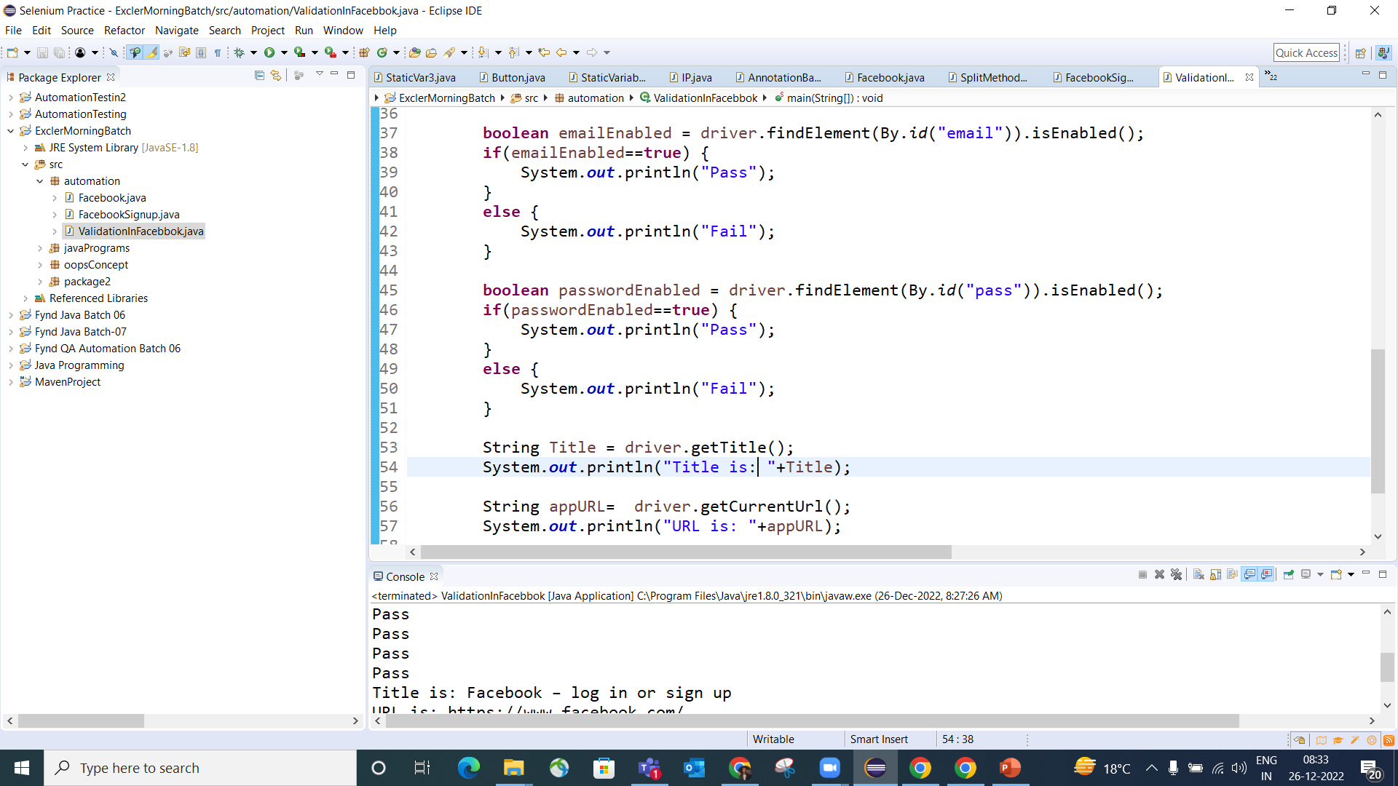

Slide 4
VALIDATION COMMANDS IN WEBDRIVER
getTitle ():
To capture the title of the application.
Syntax: driver. getTitle ();
getCurrentUrl ():
To capture the current URL of the application.
Syntax: driver. getCurrentUrl ();

Slide 5
VALIDATION COMMANDS IN WEBDRIVER
getAttribute ():
To capture the locator value of the element from the application.
Syntax: driver. findElement (by. locator(“value”)). getAttribute ();
getTagName ():
To capture the HTML tag name of the element.
Syntax: driver. findElement (by. locator(“value”)). getTagName ();

Slide 6
VALIDATION COMMANDS IN WEBDRIVER
getSize ():
To capture the size of the element.
Syntax: driver. findElelement (by. locator(“value”)). getSize ();
getText ():
To capture the name of the element.
Syntax: driver. findElement (By. locator(“value”)). getText ();

Slide 7
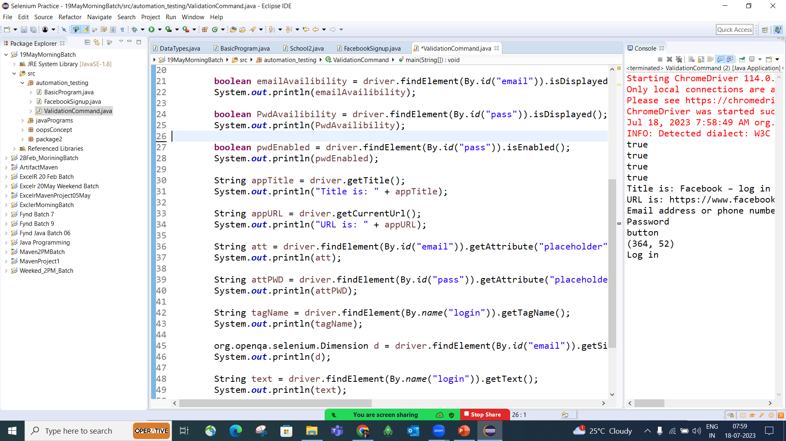

Slide 8
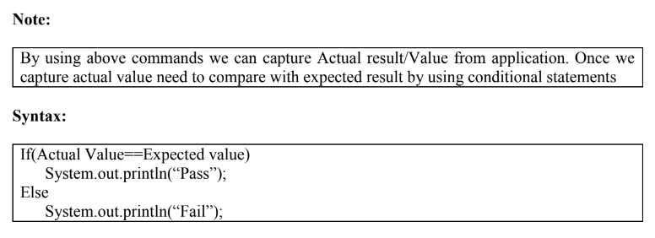

Slide 9
Example: Prepare the test script for the below test case
Sl. Number | Description | Expected result
1. | Launch Facebook App | Application title length should be greater than application URL length
2. | Click on the Log In button | Log In button should be available and should be enabled
3. | Click on Forgot Password link | Title of the page should not contains “password1”
4 | Verify the Search Button | Search Button should be available, and it should be enabled.

Slide 10
FAQ’s:
1. How can we verify the availability of Element
2. Write program to verify application title should contains “abcd”
3. Write program to verify application url should contains “.com”
4. Write a program to verify element tagname should be “select”

